Slide 1

DIGITAL PORTFOLIO
STUDENT NAME: SWATHI R
REGISTER NO AND NMID: 2422K0506/asbru202422k0506
DEPARTMENT: BACHELOR OF SCIENCE WITH COMPUTER SCIENCE
COLLEGE: THAVATHIRU SANTHALINGA ADIGALAR ARTS SCIENCE AND TAMIL COLLEGE / BHARATHIYAR UNIVERSITY

Slide 2
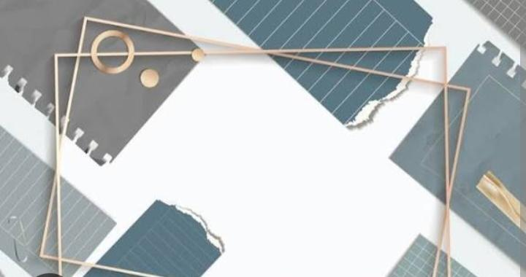
PROJECT TITLE
PERSONAL PORTFOLIO WEBSITE:
A website showcasing your skills, experience, and projects.

Slide 3
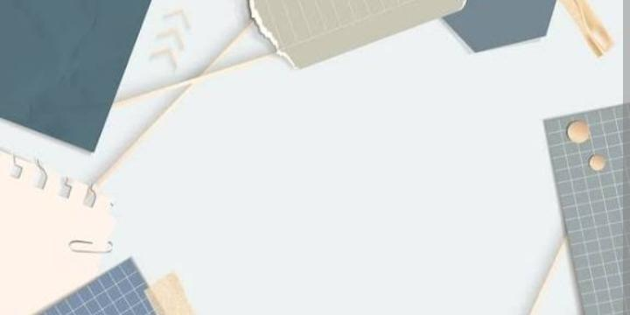

AGENDA
Problem Statement
Project Overview
End Users
Tools and Technologies
Portfolio design and Layout
Features and Functionality
Results and Screenshots
Conclusion
Github Link
3/21/2024 Annual Review

Slide 4

PROBLEM STATEMENT
As a creative professional, I realized that having just a resume or a few social media posts isn't enough to truly represent my work and skills. An online portfolio helps me display my creativity, projects, and growth in one well-organized platform. My goal is to design a portfolio that not only showcases my work beautifully but also provides a smooth and engaging experience for anyone who visits.

Slide 5
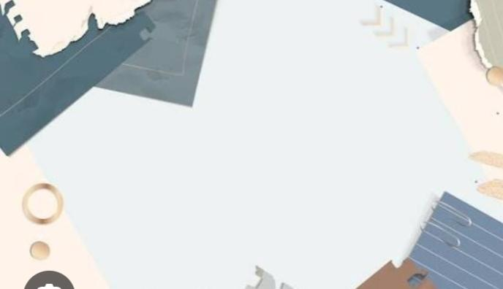
PROJECT OVERVIEW
My online portfolio is a personal website that highlights my background, skills, and creative projects. It includes sections like “About Me,” “My Work,” “Skills,” and “Contact.” Each part is designed to reflect who I am as a creative professional — showing not just what I can do, but how I approach my work with passion and attention to detail.

Slide 6

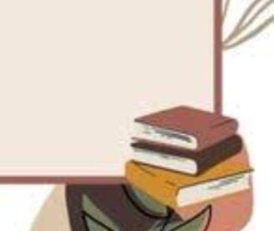

WHO ARE THE END USERS?
This portfolio mainly targets three types of users:
- Employers and Recruiters who want to assess my skills and experience.
- Clients looking for creative services or collaboration opportunities.
- Fellow Creatives such as designers, developers, and artists who may want to connect or collaborate on new ideas.

Slide 7

TOOLS AND TECHNIQUES
HTML
CSS
JAVASCRIPT
CODEPEN AS CODE EDITOR
GITHUB AS HOSTING PLATFORM

Slide 8

PORTFOLIO DESIGN AND LAYOUT
PORTFOLIO DESIGN:My design approach focuses on clarity and creativity. I used a minimalistic layout with plenty of white space to let my projects stand out. I chose modern fonts for readability and a color palette that matches my personal style. Every visual choice – from images to spacing – was made to keep the website clean, professional, and easy to navigate.
LAYOUT:I explored different layout options like grid-based and single-page structures. Finally, I decided to combine a clean grid layout for my project section with a smooth scrolling single-page design. This keeps everything accessible while maintaining a strong visual flow that feels consistent and engaging.
‹#›

Slide 9

FEATURES AND FUNCTIONALITY
1. My portfolio includes several key features:
2. Project Showcase: Interactive cards for each project, with details and links.
3. Responsive Design: Works perfectly on desktop, tablet, and mobile.
4. Contact Form: Easy for visitors to reach me directly.
5. Social Links: Quick access to my professional profiles.
6. Interactive Animations: Subtle hover effects and transitions to make the experience more dynamic.

Slide 10
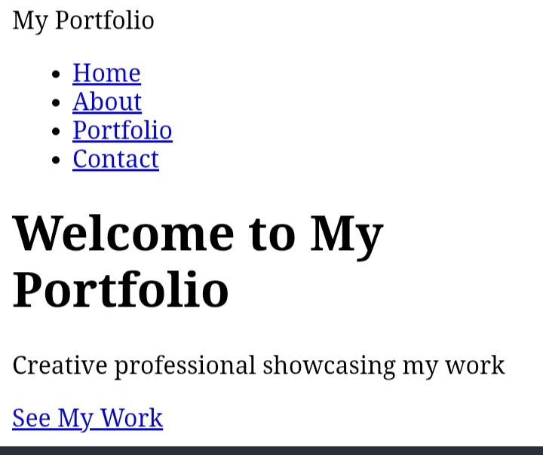
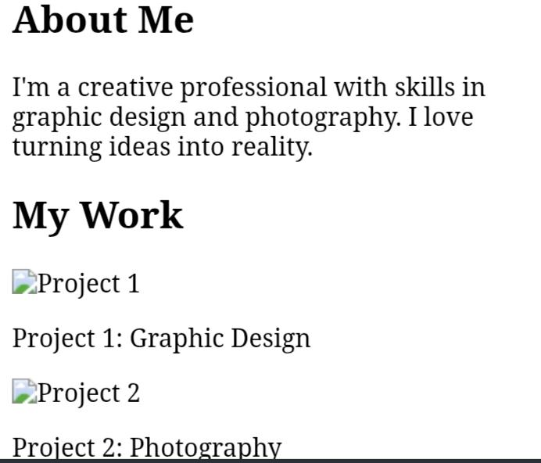
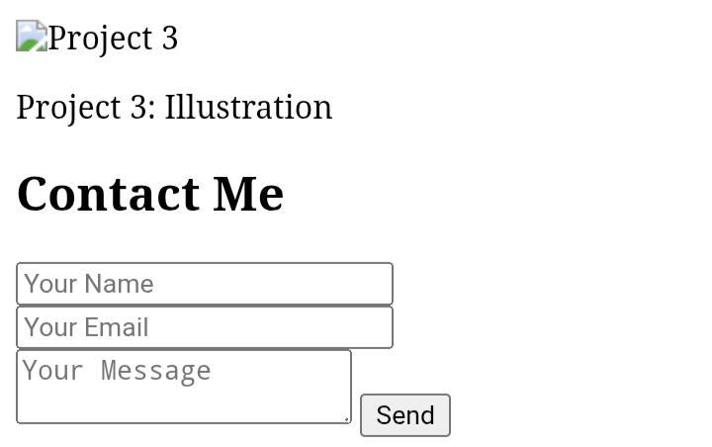
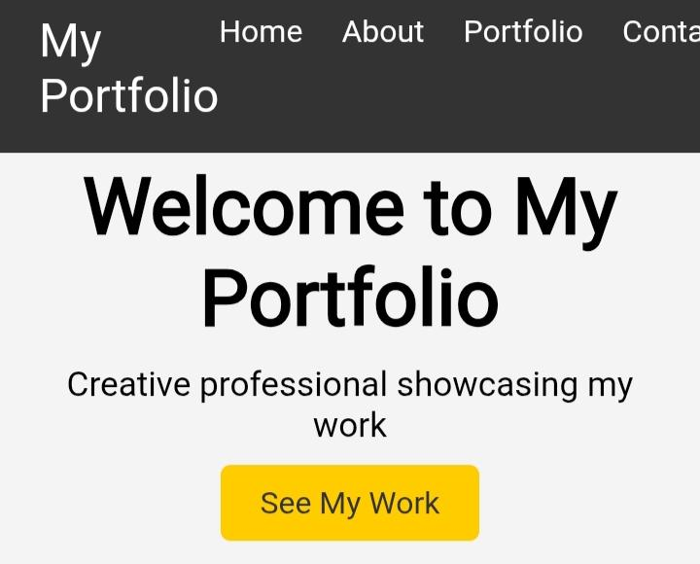
RESULTS AND SCREENSHOTS
‹#›

Slide 11

CONCLUSION
Creating this online portfolio was a rewarding experience. It taught me how to blend design and development to express my professional identity. This project represents not just my skills but also my dedication to continuous improvement and creativity. I look forward to using it to connect with employers, clients, and collaborators – and to grow further as a creative professional.
‹#›

Slide 12
GitHub link
https://github.com/geethaswathi2006-ship-it/Swathi-TNSDC-FWWD-DP

